Slide 1
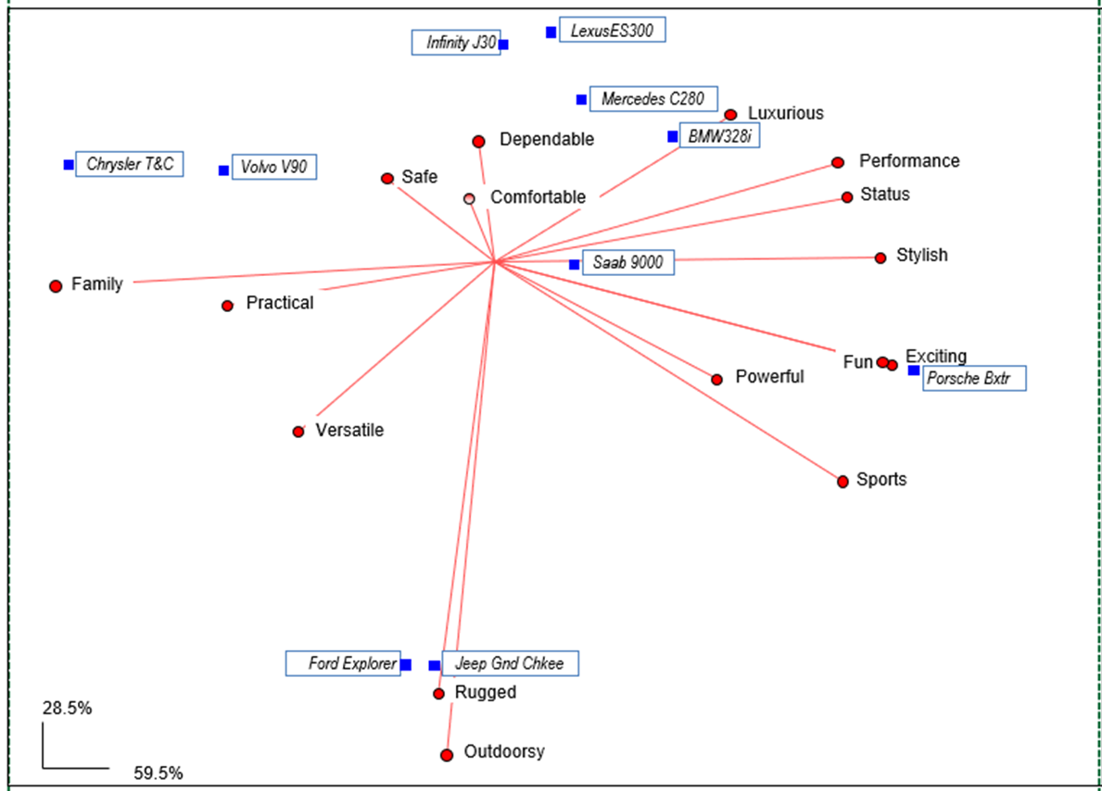
6) Perceptual Mapping Procedures

Slide 2
Mapping Procedures
Perceptual mapping procedures were developed by psychometricians to display perceptions on multiple dimensions on a map (brands, restaurants, presidential candidates, etc.).
Perceptual maps are used for exploratory analysis and to summarize information in a readily interpretable form.
This topic will cover two major approaches: 1) maps from similarity data and 2) maps from attributes-based data.

Slide 3
Similarity Maps
As the name implies, similarity maps portray the spatial representation of items based on supplied distance measures.
Similarity maps are especially useful for products/services where it is difficult to articulate attributes that differentiate items (e.g., fashion items, perfume, etc.)
Basic steps are as follows:
Identify items of interest (often competing products/services)
Create a matrix of similarity measures between pairs of items.
Generate the map and determine the dimensions. A measure of “stress” is useful in this determination. Smaller is better, and a stress=0 implies a perfect fit to the data. Another measure is the squared correlation (R square) between the distances in the data, and the distances in the map.
Interpret the map dimensions

Slide 4
Example:
As an illustration, consider the flying mileages between 10 US cities. The matrix of distances is provided below (and in SPSS file Flying.Mileages.sav)
To create the map in SPSS, click Analyze, Scale, Multidimensional Scaling
After specifying the cities, Click Model, Ratio, Continue and then
Options, Group Plots, Continue and then OK

Slide 5
Iterations stopped because
S-stress is less than .005000
For matrix
Stress = .00298 RSQ = .99996
Stimulus Coordinates
Dimension
Stimulus Stimulus 1 2
Number Name
1 Atlanta .9575 -.1905
2 Chicago .5090 .4541
3 Denver -.6416 .0337
4 Houston .2151 -.7631
5 LosAngel -1.6036 -.5197
6 Miami 1.5101 -.7752
7 NewYork 1.4284 .6914
8 SanFran -1.8925 -.1500
9 Seattle -1.7875 .7723
10 WashDC 1.3051 .4469

Slide 6
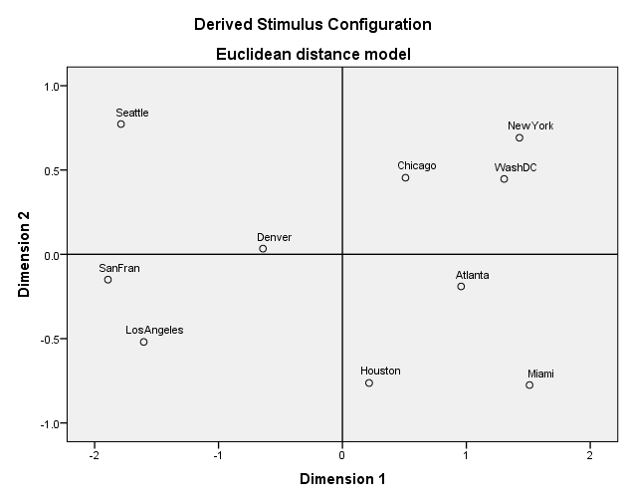

Slide 7
Example: To obtain a map of 10 competing toothpaste products, respondents were asked to rate all pairs of brands using a likert scale from
1 (very similar) to 7 (very dissimilar).
Crest vs. Colgate 1 2 3 4 5 6 7
Aim vs. Crest 1 2 3 4 5 6 7
Etc.

Slide 8
Toothpaste Example (cont.): Results for a respondent are below, and in SPSS file Toothpaste.map.data.sav

Slide 9
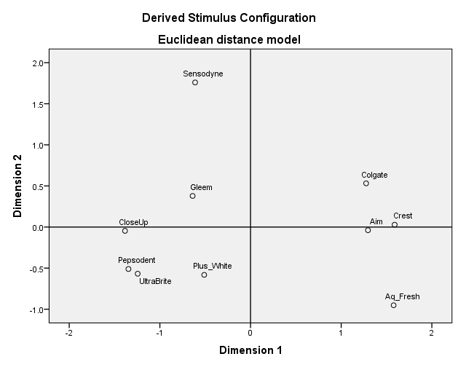
Toothpaste Example (cont.): RSQ = .89420

Slide 10
Attribute based Mapping
Attribute based methods require explicit information about the items (products/services) under study with regard to prespecified product/service attributes.
Example:
A sample of respondents were asked to rate some cars (BMW, Jeep, Chrysler, Porsche) on how well a number of attributes describe the car.
The attributes included were: Dependable, Luxurious, outdoorsy, Stylish, Fun, Family.
A scale of 1=does not describe at all, to 5=describes completely, was used. (Data is saved in SPSS file Car.A.Map.data.sav).
How to ask the questions in a survey?
How to construct the map?

Slide 11
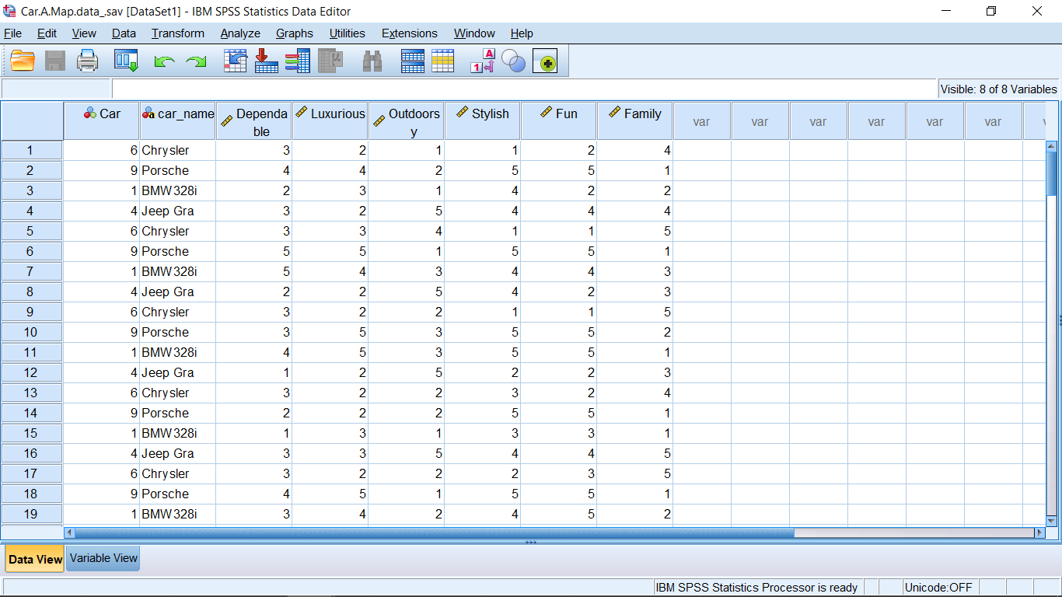

Slide 12
Steps to constructing a Factor Map
Identify the products and attributes of interest, and collect the data.
Perform a factor analysis with the attributes and determine the dimensions (factors).
Obtain the loadings for the dimensions (factors).
Obtain the mean factor scores for the products.
Plot the loadings and product mean scores.(loadings are often represented with vectors (arrows) emanating from the origin)
Interpret the map.

Slide 13
For the car example:
Factor analysis results
Mean factor scores by car from Compare Means SPSS procedure
Putting loadings and mean factor scores into SPSS file to create map

Slide 14
Map created using SPSS scatter plot
18%
49%

Slide 15
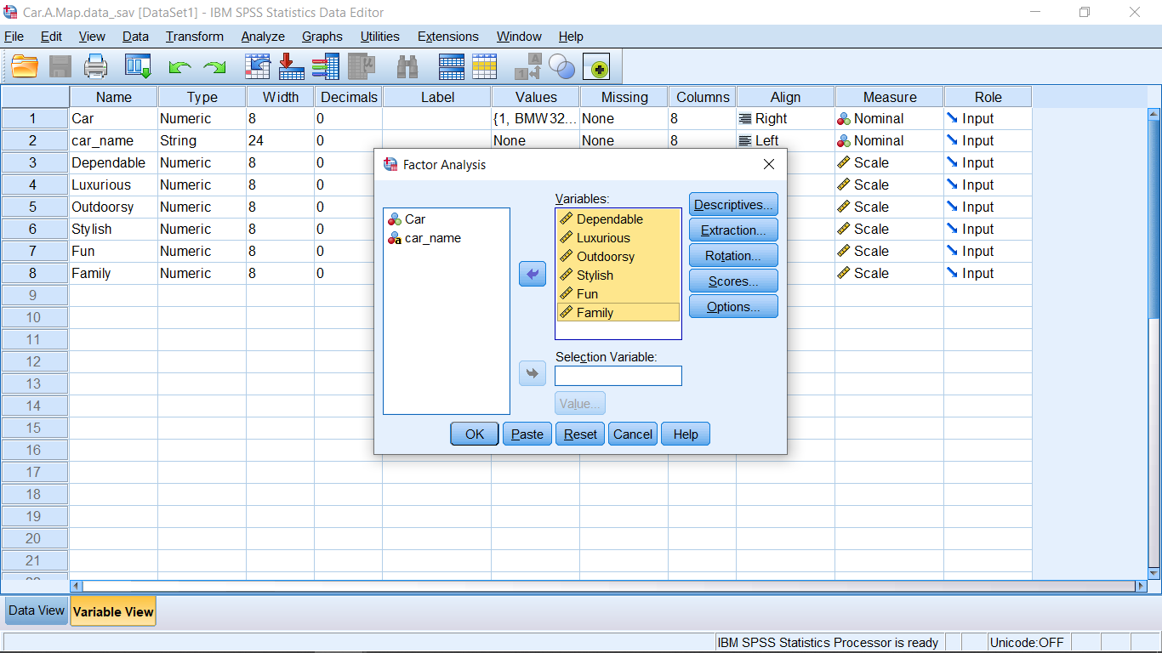
Screen shots for Car Map example.
First perform a factor analysis using the attribute variables . Request Varimax Rotation, loadings sorted by size, and save the factors as variables

Slide 16
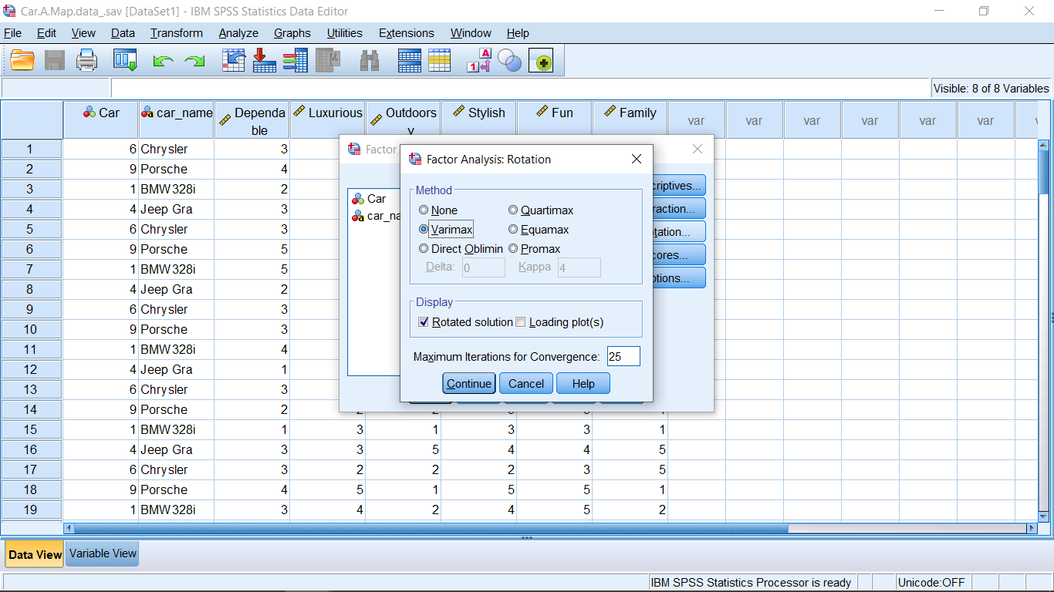
Varimax rotation

Slide 17
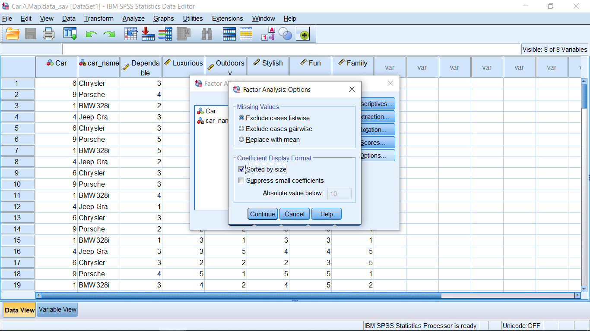
Loadings sorted by size

Slide 18
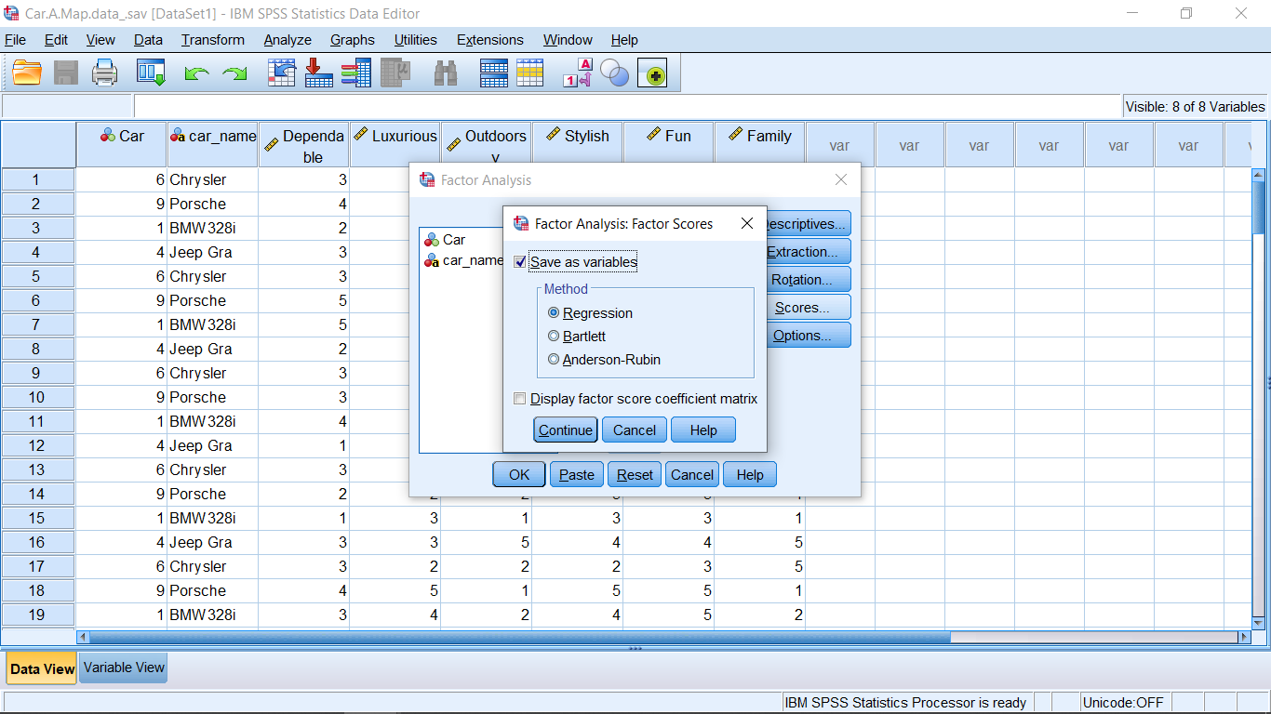
Save factors as variables

Slide 19
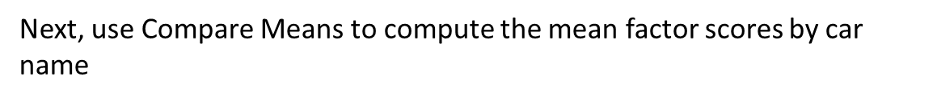
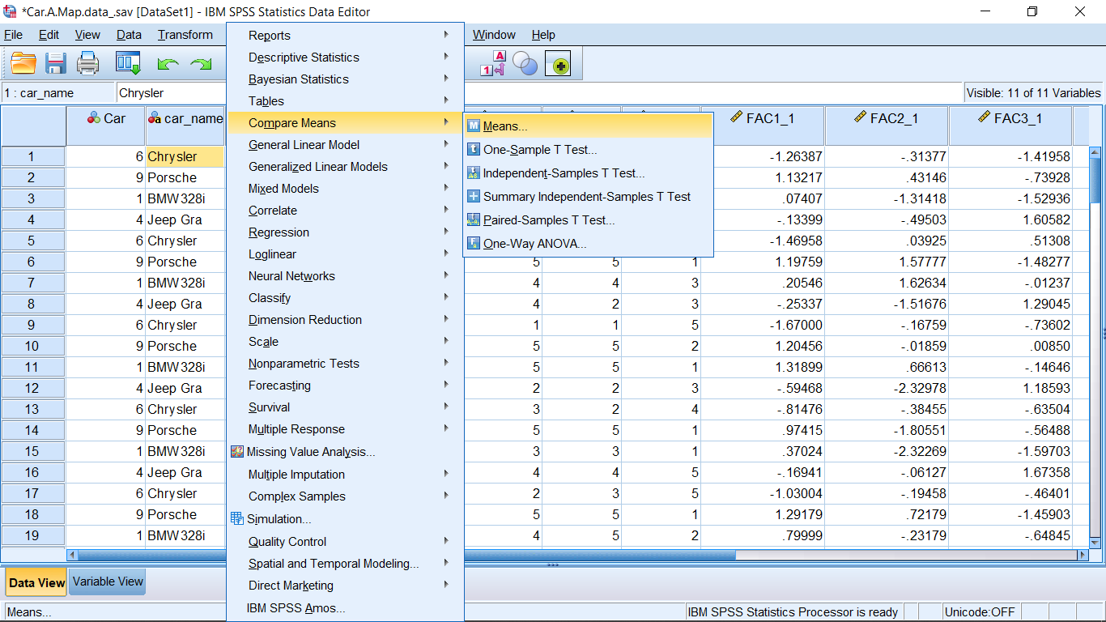

Slide 20
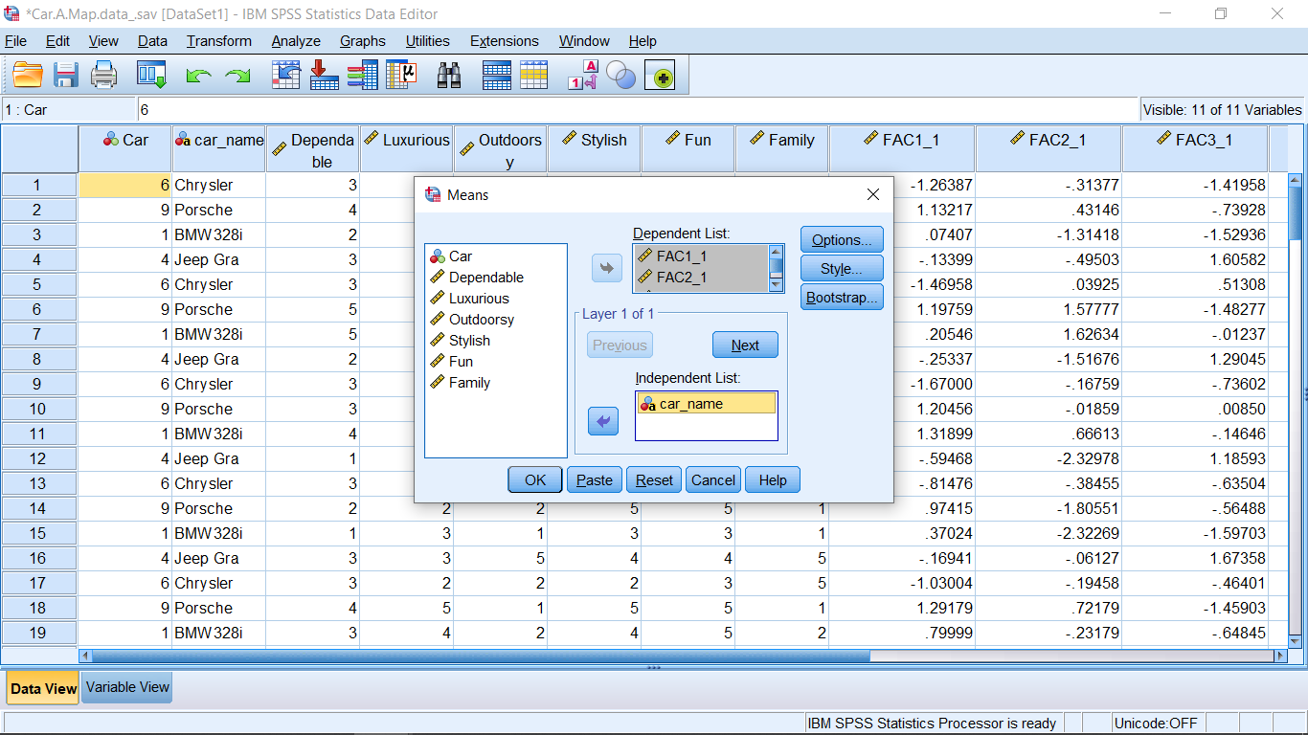
Next, use Compare Means to compute the mean factor scores by car name

Slide 21
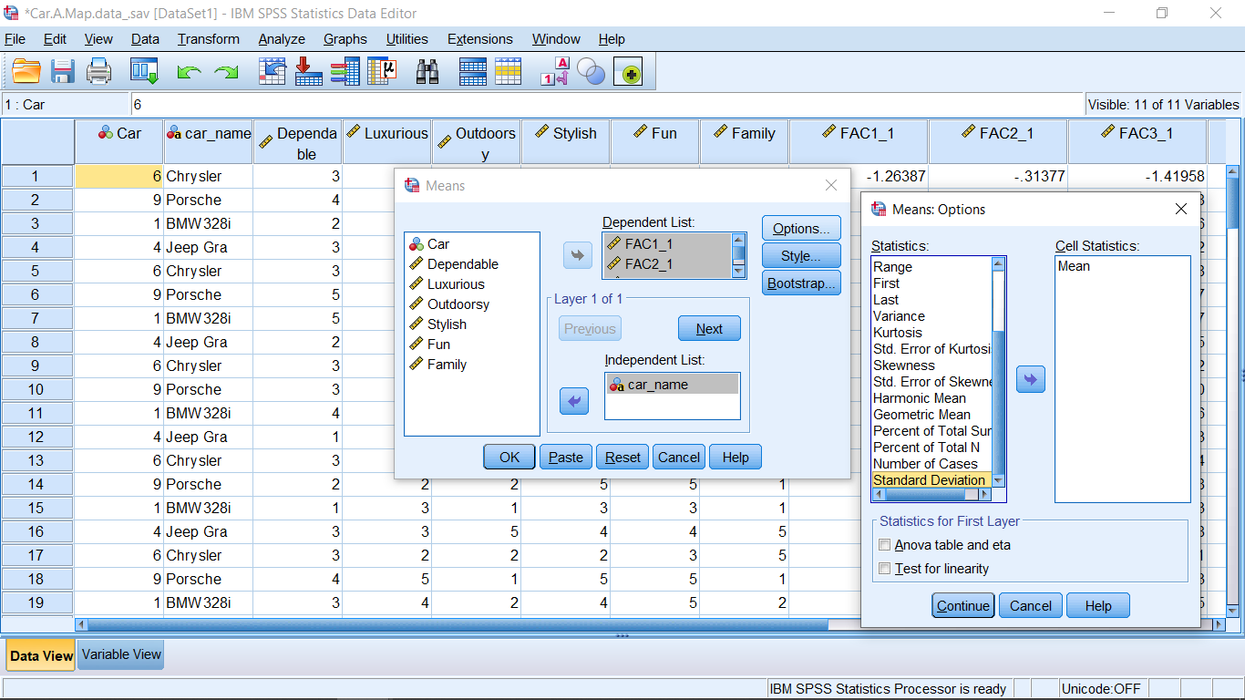
Next, use Compare Means to compute the mean factor scores by car name (only request means to keep things uncluttered)

Slide 22
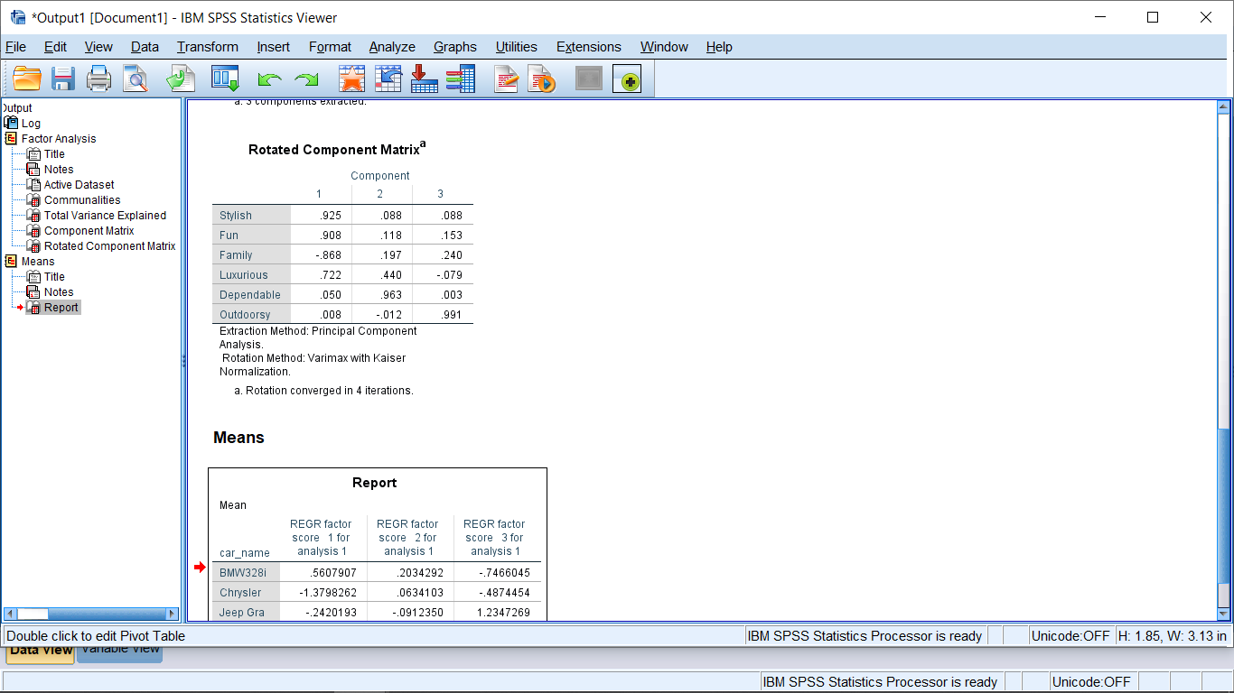
Copy and paste the rotated loadings matrix and mean factor scores (by car name) into an Excel file

Slide 23
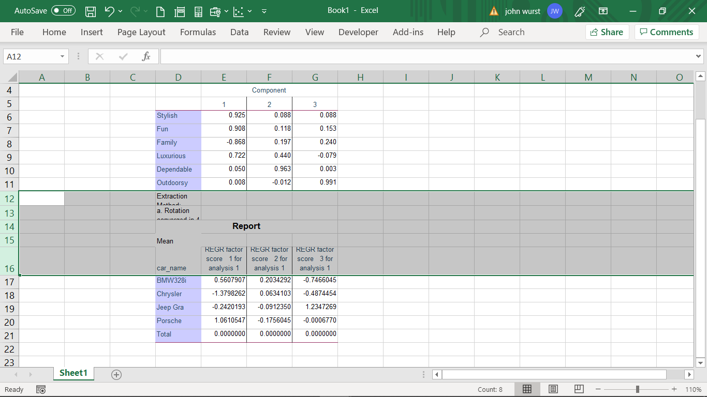
Merge the tables by omitting the rows between the output (and omit the Total row from the means table (the total means are 0s since the factors have been standardized))

Slide 24
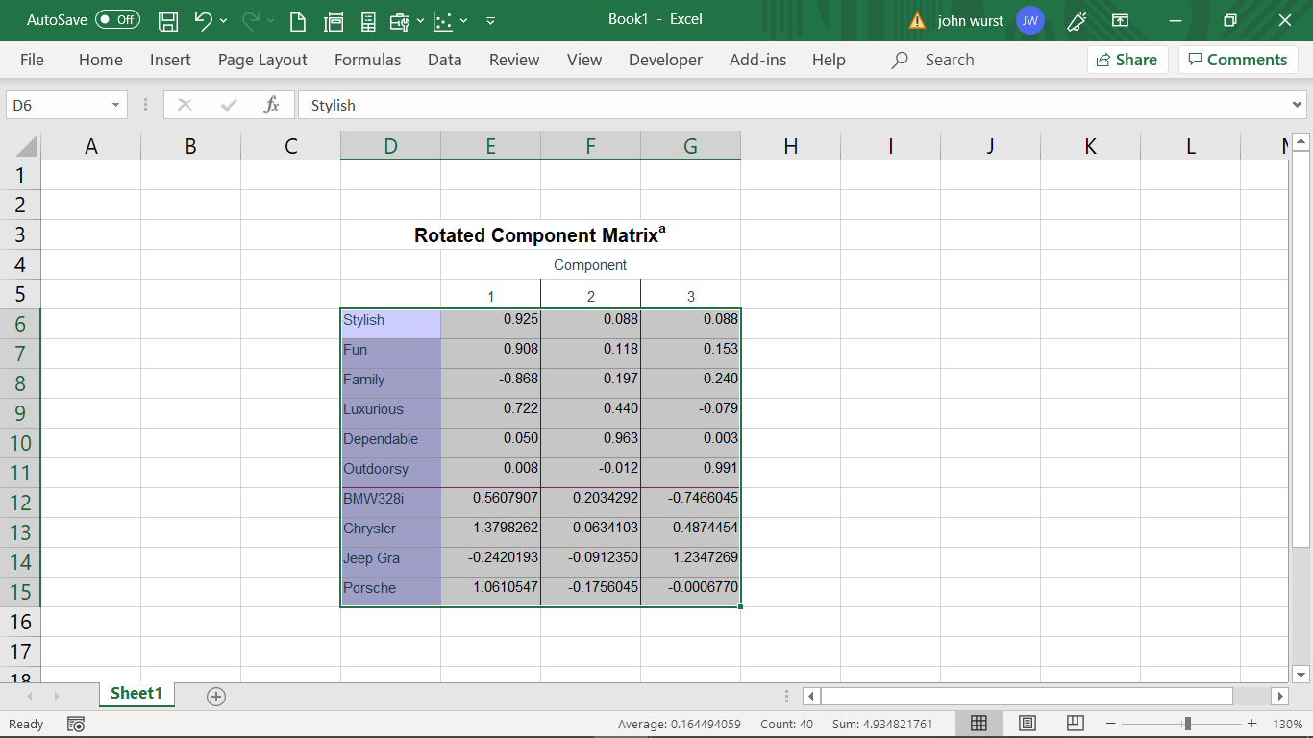
Copy the data from this table and paste into a new data file in SPSS

Slide 25
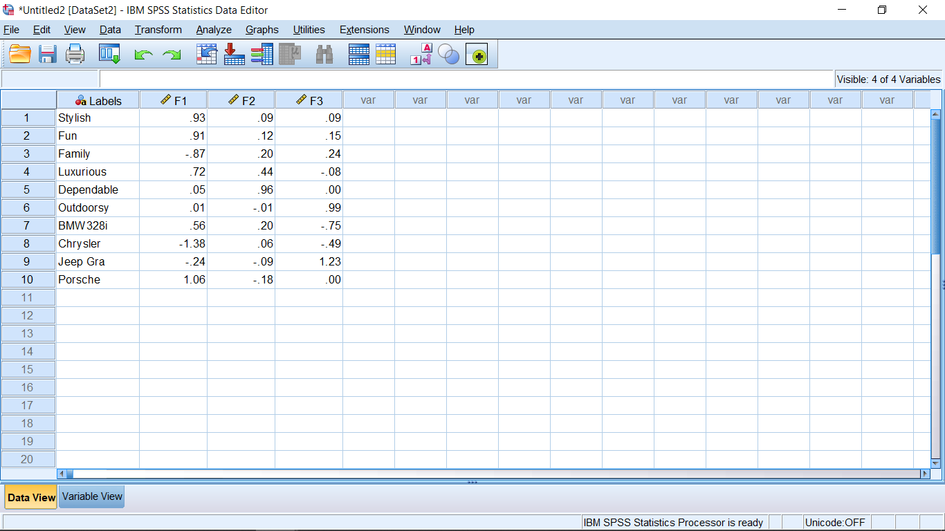
After pasting the data, you may want to rename the variables (Label, F1, F2,F3)

Slide 26
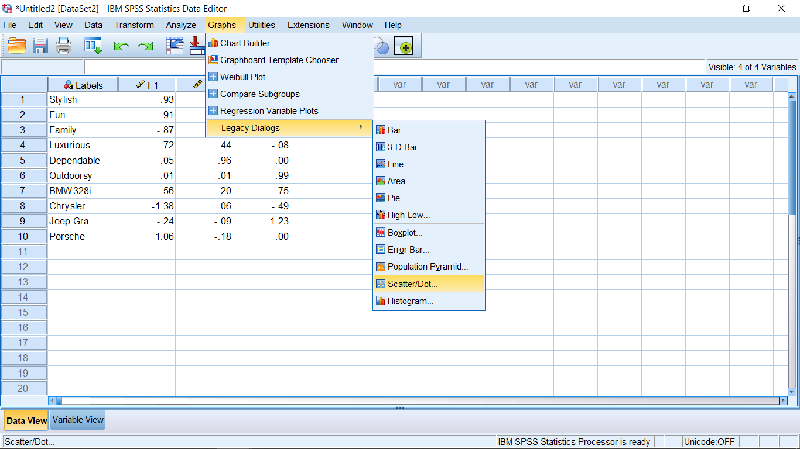
Create a scatter plot with the points labeled

Slide 27
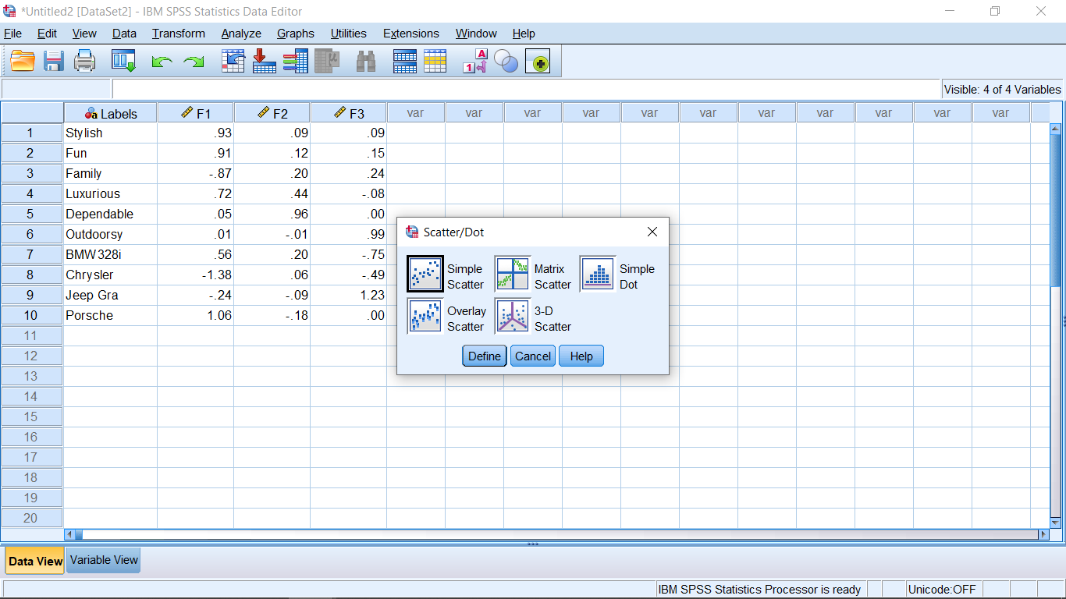

Slide 28
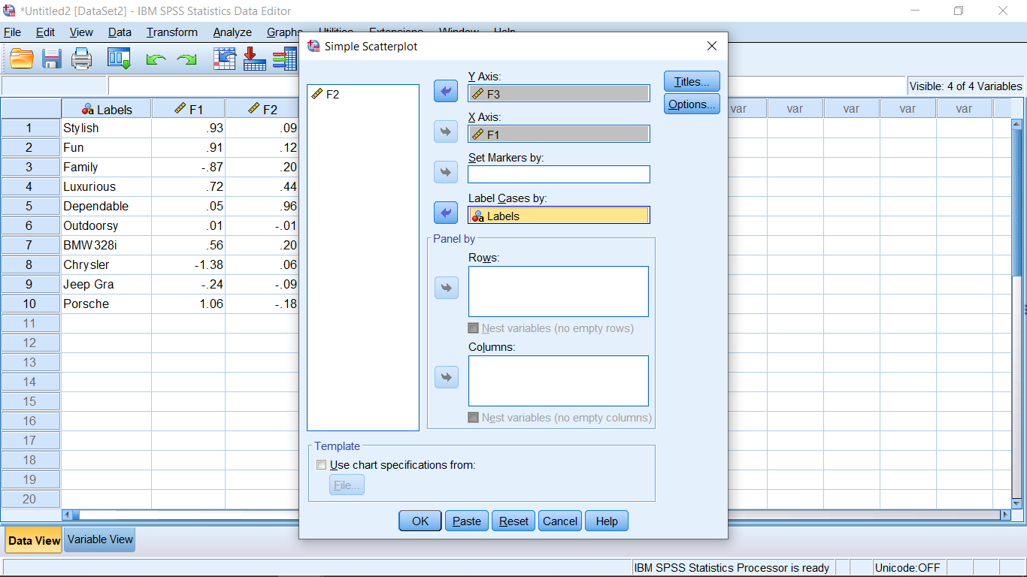
Click on Options

Slide 29
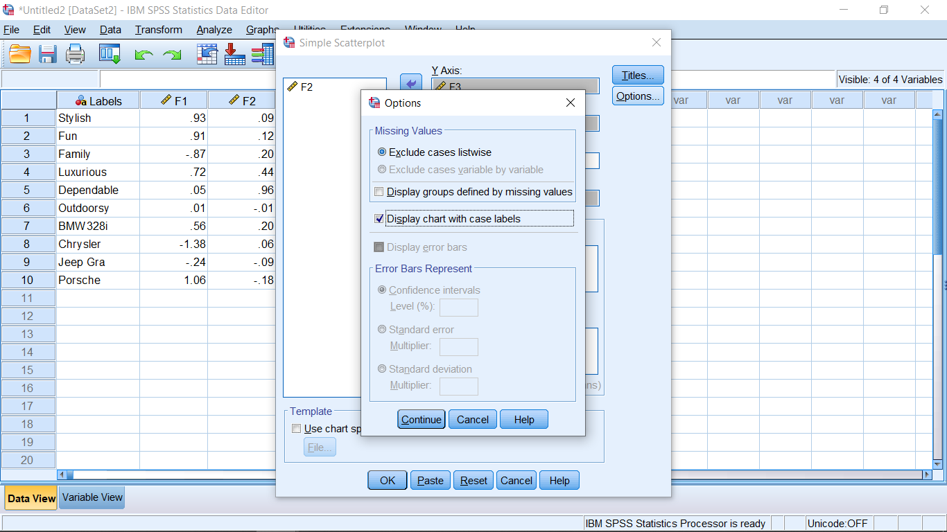
Click on Display chart with case labels, then Continue, OK

Slide 30
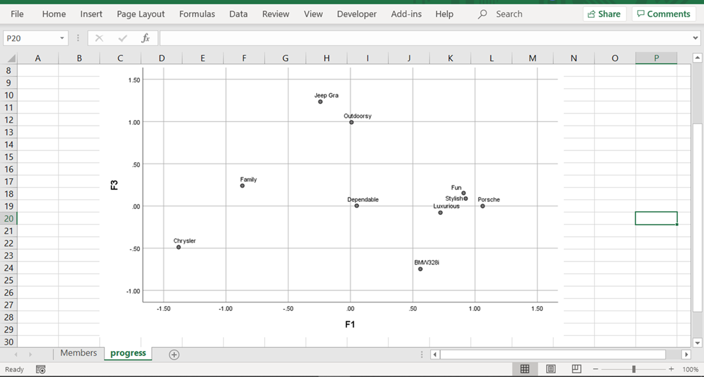
Copy and paste into Excel

Slide 31
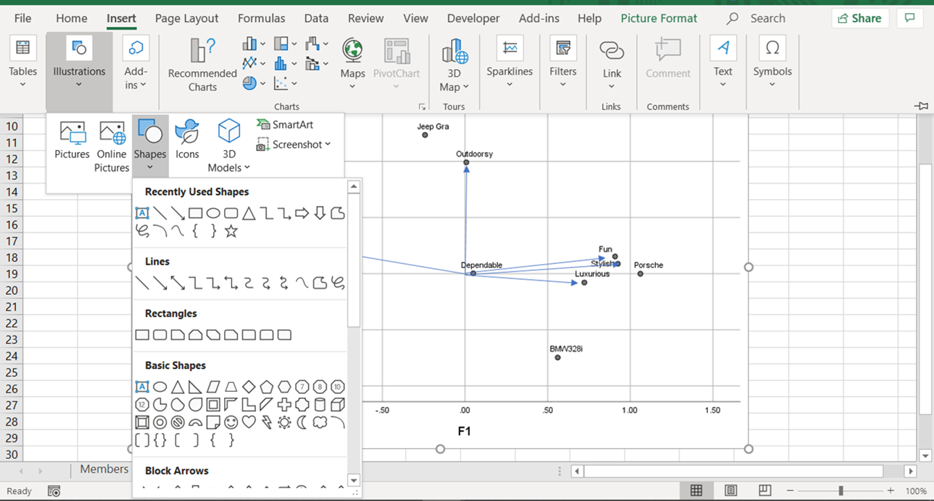
Insert arrows

Slide 32
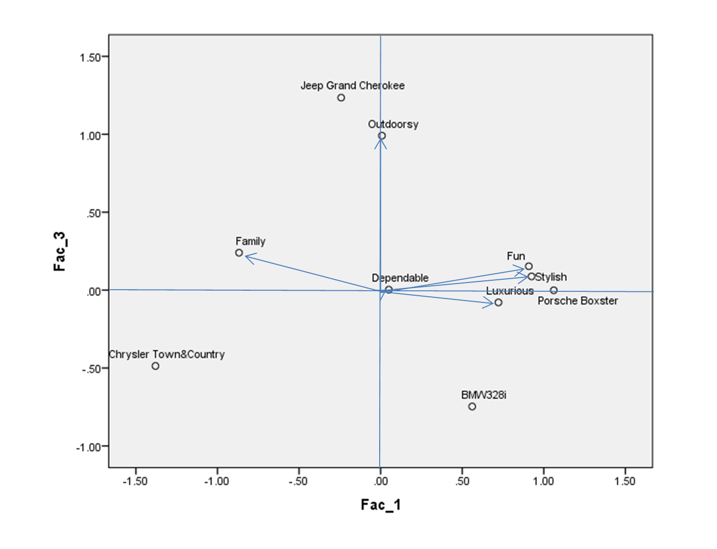


Note: Grid lines can be removed (while in SPSS) if desired
Note: the 18% and 49% are the associated factor % variance after rotation from slide 13

Slide 33
Attribute Map Interpretation
Similar products across most characteristics will appear together; very different products will appear far apart. A product scores generally well on those attributes pointing toward it, and less well on those pointing away. And the relative standing of a product with respect to an attribute can be determined by drawing a line perpendicular from the attribute vector to the product.
Angles between the vectors represent correlations. 90 degrees = no correlation. Less than 90 degrees is positive correlation, and more than 90 is negative correlation.
The longer the vector, the larger the role of the corresponding attribute in defining the space.
Remember that the maps typically only represent part of the total information in the data. It is good practice to convey how much info. is contained in each dimension in the lower left corner of the maps (%s).

Slide 34
Added Application 1
SPSS file Retail.MDS.data.sav contains a matrix of similarity measures summarized for a study where respondents were asked to rate the similarity of retail stores on a scale of 1 (very similar) to 8 (very dissimilar). The stores included were Walmart, Target, Nordstrom, Dillards, Sears, NeimanMarcus, and Lord&Taylor.
Obtain a similarity map and asses the fit. How would you interpret the dimensions of the map?
Added Application 2.
Create the map presented in slide 14, and also a map using the first two factors.

Slide 35
SAS Code for MDS Similarity Maps
proc import datafile=“D:\FlyingMileages.sav” DBMS=SAV OUT=fmd;
run;
proc mds data=fmd level=ratio;
run;
*Level specifies measurement level. For interval data use level=interval;
*Note: relative position is recovered but absolute position/orientation is not, so for example, the city distances is recovered but the orientation may be off such as the city map appearing upside down;

